Slide 1

Deep Learning with Keras
What is Deep Learning

Slide 2
Related Terms
Big Data
4V (Volume, Variety, Velocity + Value, Veracity)
Data Mining
Until finding features.
AI
Artificial Intelligence
Machine Learning
AI > Machine Learning > Deep Learning
Can study with Neural network

Slide 3
Learning?
Supervised learning teach correct answer, then study it. -> classification, regression
Unsupervised learning
no label, cluster with similar datas.
Reinforcement Learning
prize, penalty -> reward, reduce penalty

Slide 4
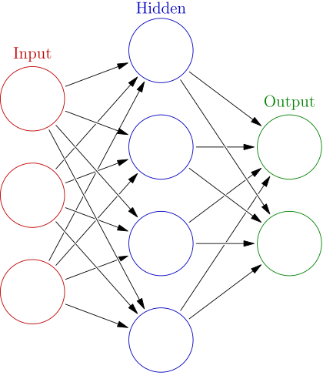
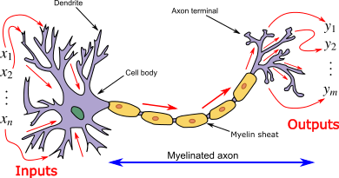
Neural Network (N·N) ? ANN !!

Slide 5

Artificial Neural Network (ANN)
자세
군인
군의관
헤어
의사
말

Slide 6
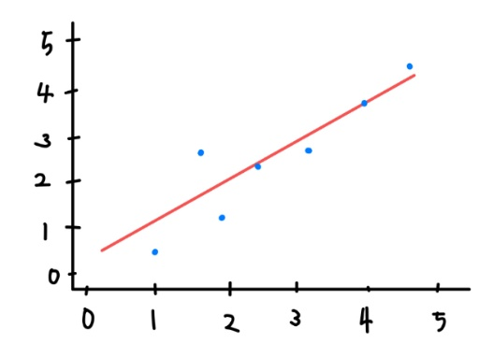
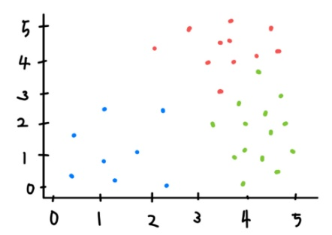
Classification & regression

Slide 7
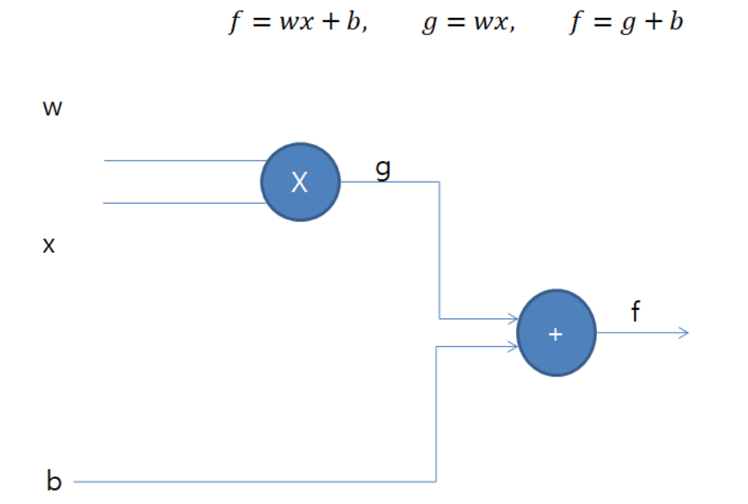
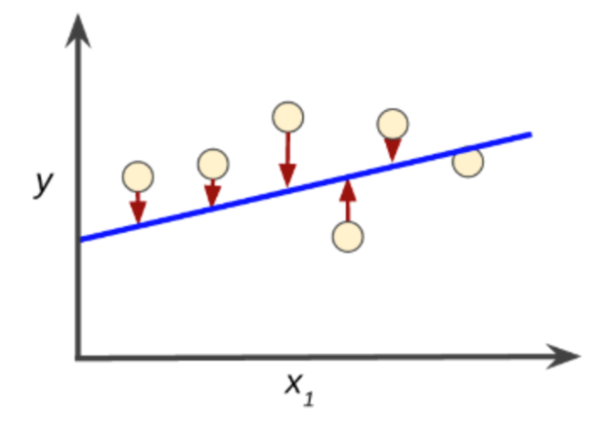
Magic of Weight and bias

Slide 8
weight
Value priority
Parameter
Weight is a parameter that controls the degree of influence that the input signal has on the resulting output.

Slide 9
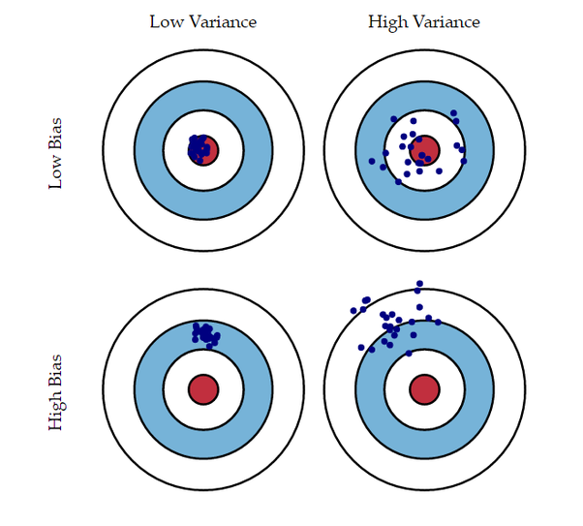
Bias & Variance

Slide 10
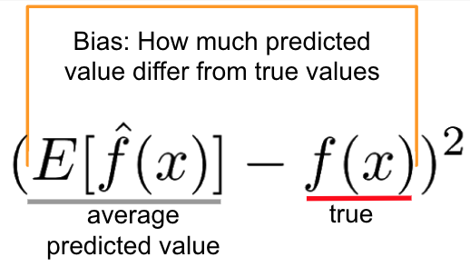
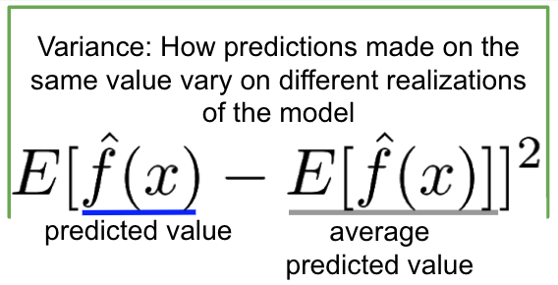
Bias & Variance

Slide 11
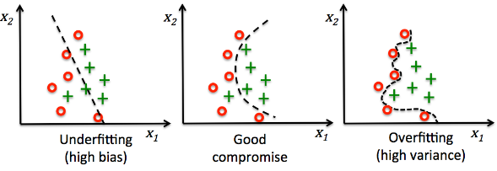
fitting

Slide 12
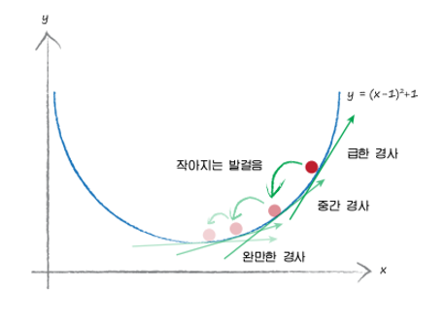
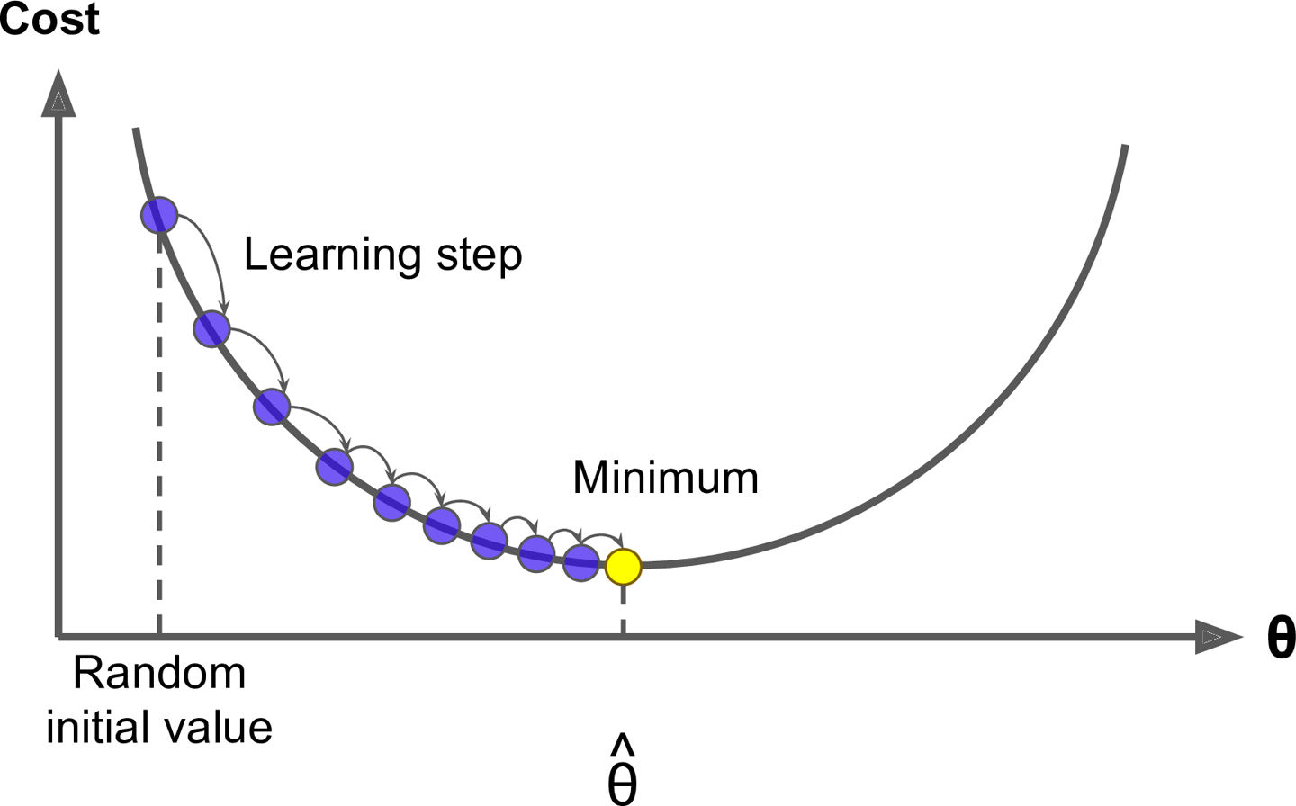
Gradient Descent algorithm

Slide 13
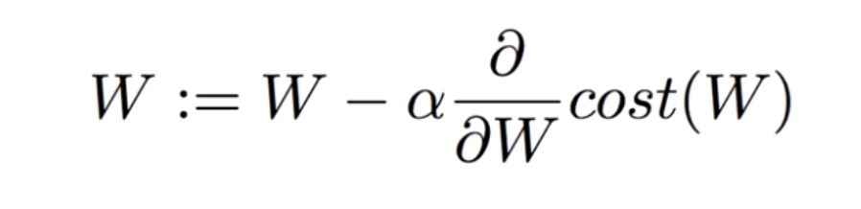
Gradient Descent algorithm

Slide 14
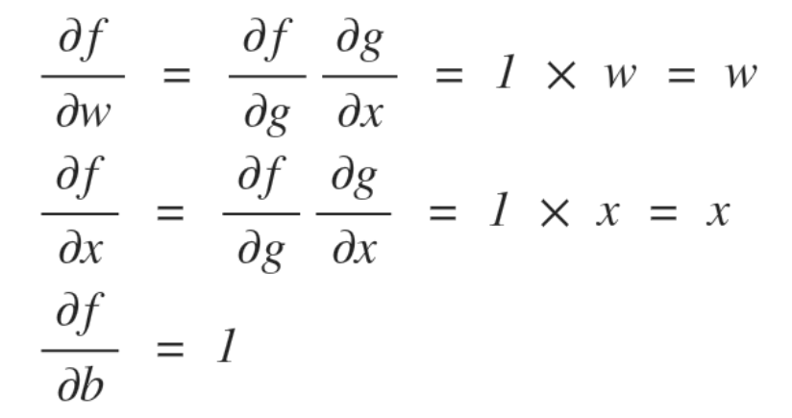
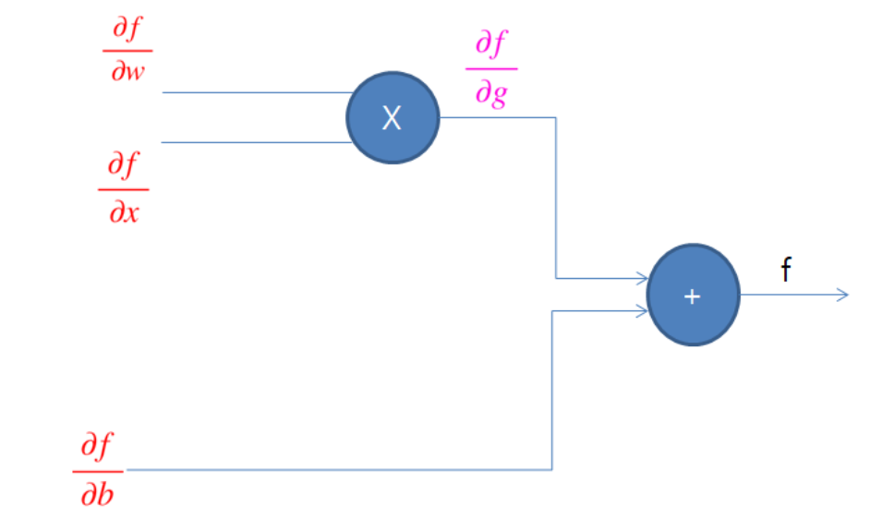
backpropagation

Slide 15
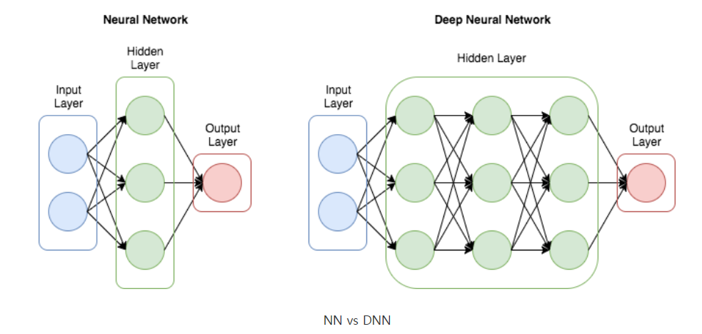
What is Deep?

Slide 16
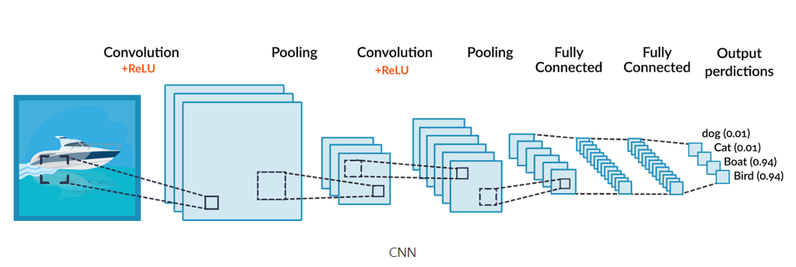
Convolution neural network(CNN)

Slide 17
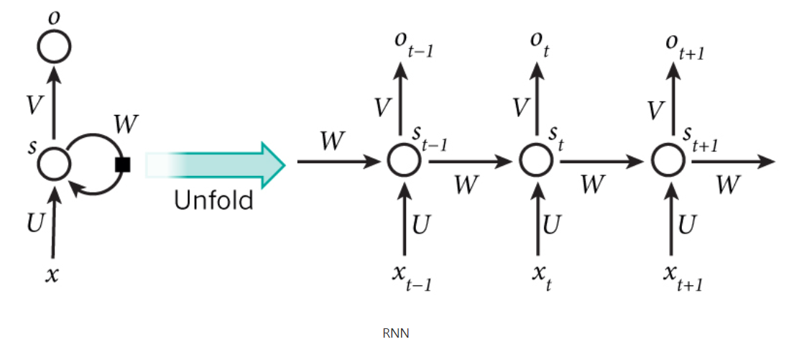
Recurrent Neural Network(RNN)

Slide 18
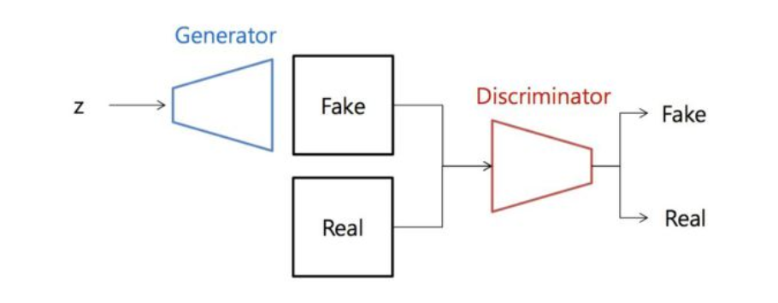
Generative Adversarial Network

Slide 19
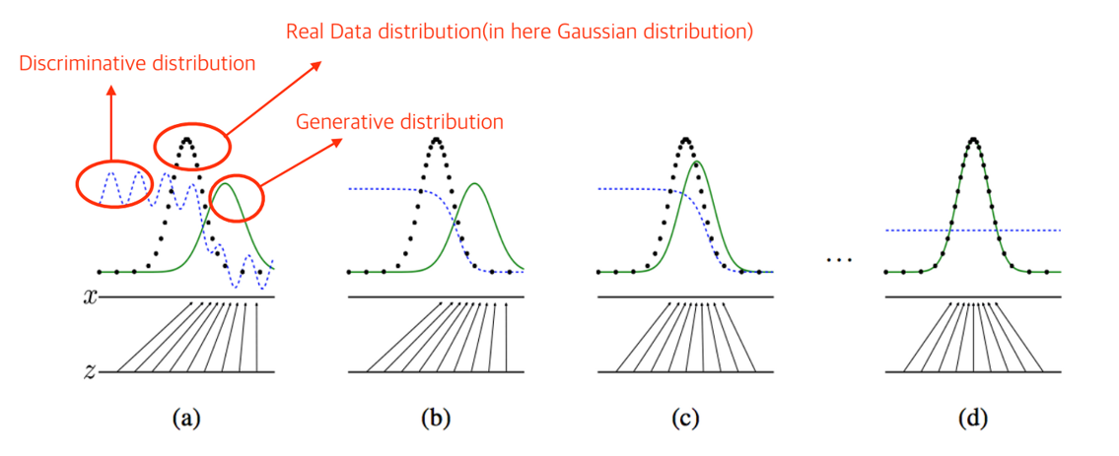
GAN

